Slide 1


Thankfulness
&
Mental Well-Being
AI-generated image (ChatGPT)

Slide 2
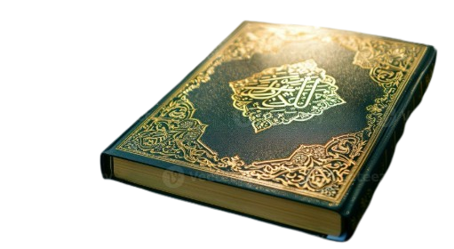

Allah says in the Holy Qur’an:
‘If you are grateful, I will, surely, bestow more favours on you;…’
(Holy Qur’an, 14:8)
The Holy Prophet^{(pbuh)} said that faith is divided into two parts:
PATIENCE and GRATITUDE.
Patience gives rise to gratitude, and so in essence having faith means being thankful to Allah.
The Holy Prophet^{(pbuh)} also said that a believer has nothing but good fortune:
If a believer experiences something positive, they are grateful, and this is good for them.
And if they experience some sort of difficulty, then a believer exhibits patience, and this too is good for them, for God says, ‘Surely, Allah is with the steadfast’, and He says, ‘Give glad tidings to the patient’.
(Friday Sermon Hazrat Khalifat-ul-Massih V, July 17, 2026)

Slide 3

Why Mental Health Matters
1. It Affects Every Part of Our Life
Our mental health impacts how we think, feel, how we deal with others and how we make decisions.
2. It Shapes Our Future
The habits and skills we develop as children will stick with us as we grow older. Learning how to care for our mental health now sets us up for a happier, more balanced life in the future (Insh’Allah).
3. It is Linked to Our Physical Health
Our mental health and physical health are closely connected. Taking care of our mind can improve
our overall well-being.
https://www.compassroseinternational.org/the-importance-of-mental-health?gad_source=1&gad_campaignid=24018540160&gbraid=0AAAAAC80Imao1miC4kp-gaSK2DUiWMRE9&gclid=CjwKCAjwsfzSBhB5EiwAOGyqSVAe31VpIuoKs9Imyav_9y2IAYjINIp0dXvT-venKkJWftCDEpQpexoC5w8QAvD_BwE

Slide 4
Islam teaches us that if sadness or worry overtakes us, our hearts can still be at peace through different avenues:
Remembrance of Allah:
“Aye! it is in the remembrance of Allah that hearts can find comfort;” (Holy Qur’an, 13:29).
We can remember Allah through many avenues: offering Salat, giving charity, reading (religious) books, admiring Allah’s creation, being thankful, reflecting on Allah’s attributes…..
Sense of Belonging:
If we feel like we do not belong anywhere, we can find comfort in our faith and in our Jamaat.
Sometimes spending more time with family and friends can help boost our mood as well.
If boredom is causing unhappiness, we should find things to keep ourselves busy: more schoolwork, finding a new job, volunteering in our community, etc.
Exercise is a great way to relieve any stress!
You can also boost your mood by doing something creative: painting, cooking, drawing…
Being Positive:
If you wake up and look at everything with a negative outlook on the world, you will ultimately not feel great about your day;
however, if you look at life in a positive manner, you may be able to see the good in things.
Talking To A Trusted Person:
If something is affecting your mood, try talking to someone you trust to get your feelings off your chest.
(https://www.alislam.org/book/quest-of-curious-muslim/mental-health-how-can-i-be-happy/)

Slide 5

Gratitude can help reduce stress and improve emotional well-being.
What makes gratitude an especially useful tool is that we all have access to it and we can work on developing it further.
How Gratitude Reduces Stress:
Stress often stems from focusing on what’s lacking or what’s going wrong.
Gratitude does the opposite; by intentionally acknowledging what’s going well — even small things— we shift our attention away from stressors and negative feelings, toward sources of comfort and joy.
Over time, this practice can help us feel more grounded and better equipped to handle life’s ups and downs.
https://samhealth.org/news/gratitude-a-simple-practice-for-profound-mental-health-benefits/

Slide 6

The power of Gratitude
Count your blessings!
Remember:
While every person struggles in their day-to-day life and feelings of unhappiness are not uncommon, it is important to make the concept of shukr (gratefulness) a part of our daily routine.
Allah says:
لَئِنۡ شَکَرۡتُمۡ لَاَزِیۡدَنَّکُمۡ ‘ → ‘If you are grateful, I will, surely, bestow more favours on you...’
(Holy Quran, 14:8).
An immediate result of gratefulness is that we realize the enormity of God’s blessings no matter
what the situation and we don’t take things for granted but rather are grateful for them.
AI-generated image (ChatGPT)

Slide 7
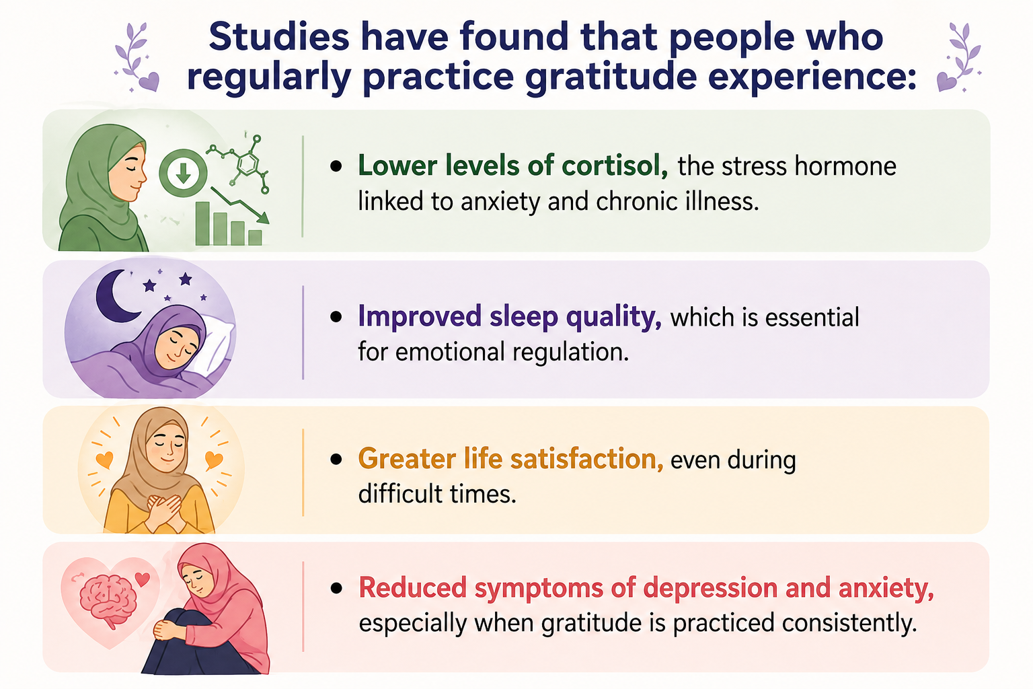
AI-generated image (ChatGPT)
https://samhealth.org/news/gratitude-a-simple-practice-for-profound-mental-health-benefits/

Slide 8
Simple Gratitude Practices to Try Today
1. Three Good Things
Each night, write down three things that went well or made you smile today. They can be big or small. This practice
has been shown to improve mood and sleep quality over time. (consider keeping a gratitude journal)
2. Gratitude Jar
Keep a jar where you drop in notes about things you’re thankful for. On tough days, pull one out and reflect on it.
3. Gratitude Walk
Take a walk and mentally note things you appreciate such as sunlight filtering through trees, a neighbor’s friendly wave
or even the rhythm of your breath.
4. Thank You Notes
Send a quick message or email to someone who made a difference in your day. Expressing gratitude strengthens
social bonds and boosts happiness for both sender and receiver.
5. Mindful Moments
Pause during your day to notice something good, whether it’s a delicious meal, a moment of laughter or a task completed.
Acknowledge it, savor it and let it sink in.
So tonight, before bed, ask yourself: What am I thankful for today?
Your answer might just be the beginning of a healthier, happier you!
https://samhealth.org/news/gratitude-a-simple-practice-for-profound-mental-health-benefits/

Slide 9
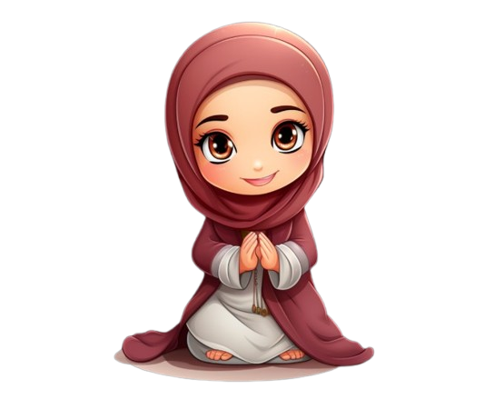
Glad Tidings for the Believers:
‘Surely there is ease after hardship.
[Aye], surely there is ease after hardship.’
(Holy Qur’an, Ch.94: V.6-7)
The Holy Prophet Muhammad^{(pbuh)} said:
“Never a believer is stricken with discomfort, hardship or illness,
grief or even with mental worry that his sins are not expiated for him.’’
(Al-Bukhari)

Slide 10
Resources
https://alislam.org/quran/app/1?options=en
https://www.alislam.org/friday-sermon/2026-07-17.html
https://www.compassroseinternational.org/the-importance-of-mental-health?gad_source=1&gad_campaignid=24018540160&gbraid=0AAAAAC80Imao1miC4kp-gaSK2DUiWMRE9&gclid=CjwKCAjwsfzSBhB5EiwAOGyqSVAe31VpIuoKs9Imyav_9y2IAYjINIp0dXvT-venKkJWftCDEpQpexoC5w8QAvD_BwE
https://www.alislam.org/book/quest-of-curious-muslim/mental-health-how-can-i-be-happy/
https://www.alhakam.org/spirituality-and-mental-well-being
https://samhealth.org/news/gratitude-a-simple-practice-for-profound-mental-health-benefits/
https://sunnah.com/riyadussalihin:37

